Slide 1
Week 8
Advanced Network Communication
Server-side computation
Linear Predictive Coding

Slide 2
HTTP Communication
Previously, we went over the basics of HTTP
GET, POST, Headers, etc….
We quickly ran through using Google’s services to do speech recognition via POST’ing FLAC audio
This week, we’re going to learn how to do that part
We’ll write a simple HTTP server
We’ll have it process some data, somehow
We’ll send it back to the client
In order to get all this to work together, there is a stack of technologies that must cooperate

Slide 3
HTTP Communication
To do this we need:
A webserver running on a server, to handle HTTP (We’ll use nginx)
Code to run when a certain URL is POST’ed to (We’ll use python/flask)
An agreed-upon method of interpreting said data (We’ll use JSON)
A library to do all the tough, numerical lifting (We’ll use numpy)
We’re not going to set up a webserver from scratch
It’s long and boring, and belongs in the iSchool department
Plus, there are many web tutorials that are excellent
We are going to get a feel for what this feels like!

Slide 4
Python
Very popular language in many fields
Webservices, scientific computation, desktop services/automation, etc…
Interpreted, very high-level language
Closer to MATLAB than C, gives the programmer some breathing room
We’re going to use the Flask framework
Super. super simple, very easy to use
Will basically allow us to map URLs to functions

Slide 5
Live Python Demo
Just to give you a feel for the syntax

Slide 6
Live Flask Demo
Give you an idea on how easy it is to setup

Slide 7
Numpy/SciPy
These are two python libraries for computation
They complement eachother, and provide a MATLAB-like environment
We’ll use them to do some simple data processing
Something ridiculous like returning x * fft(x) or somesuch
If you’ve used MATLAB before, this will look familiar
You can even do interactive data plotting, etc…
Obviously, a webserver won’t pop up interactive plots though

Slide 8
Live SciPy demo

Slide 9
Putting it all together
Now, we need to bring together all we’ve done
Make a POST request to Flask from the phone, encoded as JSON
Read the JSON in on the Flask side
Sic SciPy on it, to do numerical calculations
Encode the result as JSON, send it back to the phone
Let’s do it!

Slide 10
MATLAB
Abandoning HTTP, MATLAB has some interesting features that we can take advantage of
Namely, it is built on top of Java!
This means that we can use Java’s sockets!
We’re going to do direct, binary communication now
We’ll use the 4-byte [LENGTH] followed by LENGTH-byte [DATA] protocol
With this, we’ll be able to pump data into MATLAB, and pump data from MATLAB into our phone!
If this doesn’t excite you, you might need to go see a doctor

Slide 11
Java Sockets
As stated previously, Java and C# are pretty close
Both created to fill the same gap
As such, their APIs are often quite similar
To use Java inside of MATLAB:
function server(output_port)
import java.net.ServerSocket
import java.io.*
end

Slide 12
Java Sockets Demo

Slide 13
Advanced Sockets
Moving beyond Client ←→ Server, we need tools
Tools to make communication easier to setup, and more robust
One of my favorite tools to achieve this is ZMQ
The “Zero Message Queue”, stylized ØMQ
Builds upon sockets to create a messaging framework
The base unit of communication is a frame, not a stream
Many different socket types, each with their own specialty
Enables very complex topologies with a minimum of low-level work
Still requires plenty of high-level work to enable this kind of flexibility

Slide 14
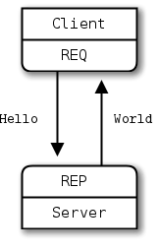
ØMQ
Simplest socket types imaginable: Request/Reply
REQ can only Send, then Receive
REP can only Receive, then Send
REP sits and listens for connections
REQs go out and connect to servers
This works for Client-Server designs

Slide 15
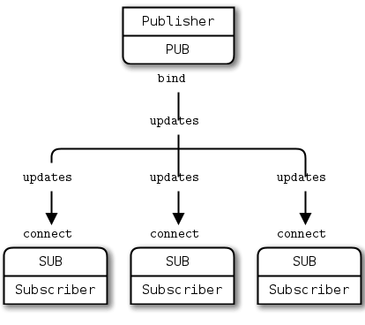
ØMQ
PUBlish and SUBscribe form a 1-way socket pair
Useful for a server talking to a multitude
Cloud to Phone status updates
Broadcast messaging

Slide 16
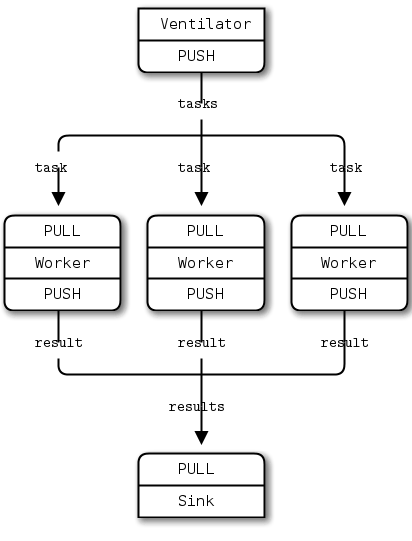
ØMQ
PUSH/PULL
Useful in a cloud computation environment
Either 1-to-N, or N-to-1

Slide 17
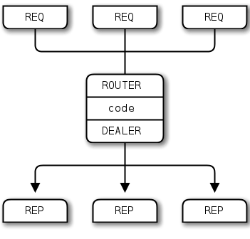
ØMQ
ROUTER/DEALER
Router can individually address N connected sockets
Dealer “deals out” to the connected sockets
Useful for load balancing
Many requests come in
They are fair-queued to worker nodes
The responses can be routed back to the clients

Slide 18
ØMQ
These socket “primitives” can be combined, to create some very interesting topologies
These sockets can also be used within a process
Provides message passing between different threads
In the creator’s words:
“The socket library that acts as a concurrency framework.”
Has a learning curve, but is completely worth it
You’ll never deal with normal concurrency or socket APIs again

Slide 19
LPC
Linear Predictive Coding
Very common signal processing technique
Decomposes a signal into two pieces, an excitation and a filter
Asks a very common signal processing question
“What linear relationship exists in my signal?”
Creates a parametric model of our signal

Slide 20
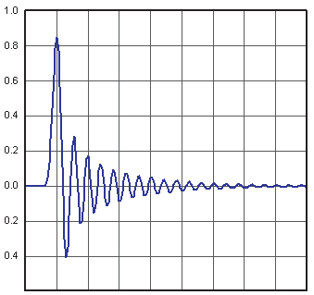
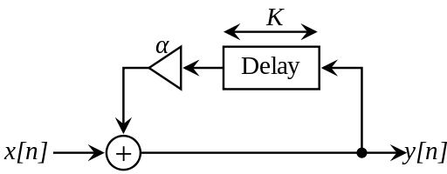
LPC
LPC uses an IIR filter model

Slide 21
LPC
LPC learns a K-order linear model, assuming that:
This also called an “autoregressive” model
LPC learns the coefficients

Slide 22
LPC Coefficients
The coefficients represent inherent structure in data
These coefficients are filter coefficients
Just like any filter, we can generate an impulse response
Just like any filter, we can throw it into the frequency domain
LPC estimates the best filter with length K
Multiple ways to interpret this:
Discover the linear structure in the signal
Parameterize the frequency response of the signal

Slide 23
LPC Computation
How do we find these coefficients?
By representing this as a matrix multiplication:
Where , and are column vectors, and is a matrix

Slide 24
LPC Computation

Slide 25
Looking forward
Final project demos: Thursday the 19th, at 6pm
Please shoot for 10-12 minutes per team
This should give us a total runtime of ~2 hours
Final project reports will also be due
Please submit these before class, just like Homework
No class next week (March 5th)
Work on your final projects!
Class will pick up again for a final meeting on March 12th

Slide 26
Further Reading
Python
Flask
Numpy/Scipy
Java in MATLAB (read both answers)
Java Sockets
ZMQ
The ZMQ Guide, from which I shamelessly stole all the socket pictures

